Slide 1
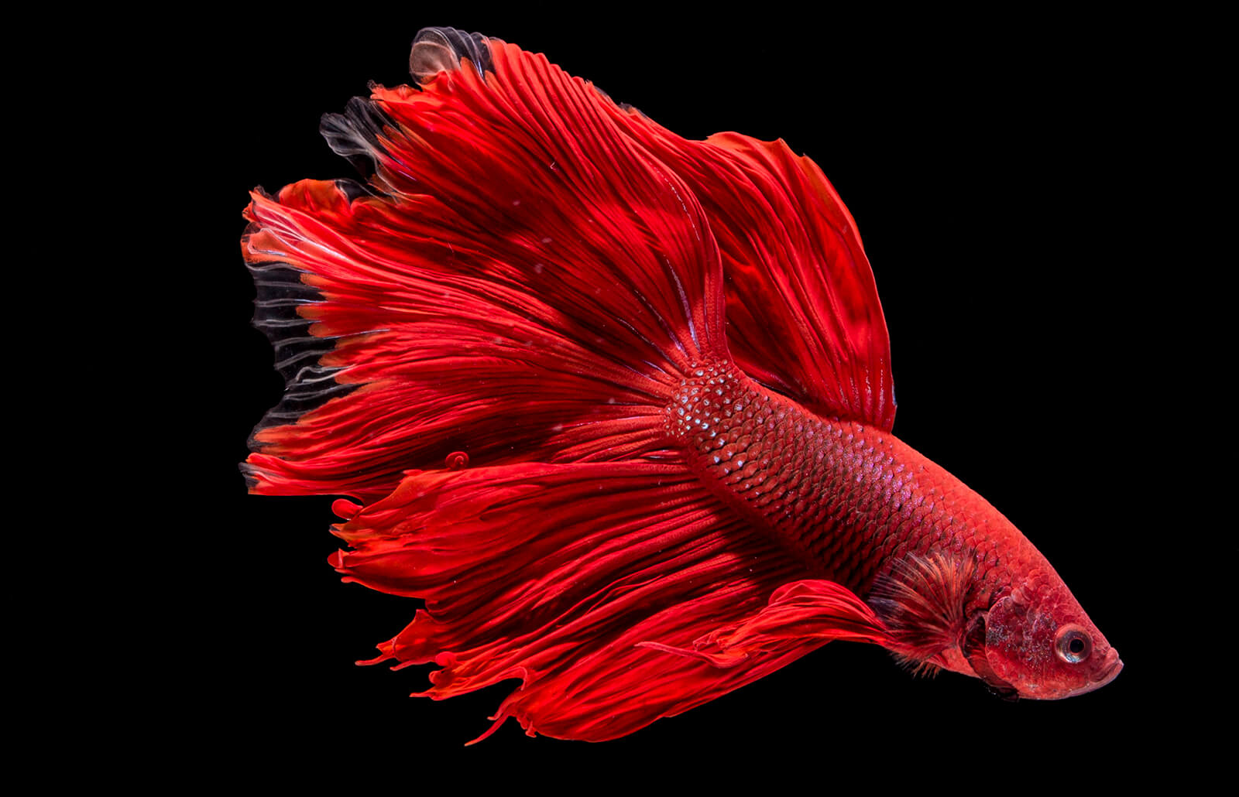
Computer Engineering
Melanie Fuhrmann
Nathan Paskach
Cyber Security Engineering
Isabella Leicht
Adan Maher
Electrical Engineering
Sarah Degen
Brandon Mauss
Software Engineering
Jack Croghan
Feederal Reserve
Team 43
Notes:
Bella

Slide 2
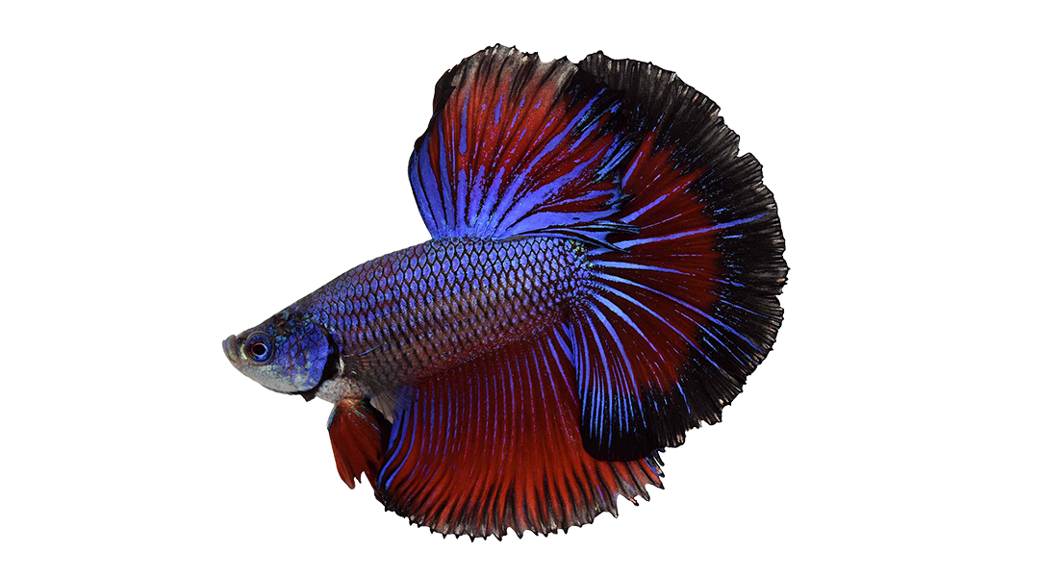
Definition
Client Needs: An easy-to-use and reliable fish monitoring and feeding device
Client has multiple betta fish in their office
Aquariums conditions can change unpredictably
Not easy to care for fish outside of work – this includes weekends and holidays
Problem: Must feed and monitor fish when caretakers are not present
Current market feeders dispense too much food for one fish
Alternative options (e.g. slow release tablets) can cause dangerous conditions
There are little to no options for a multi-faceted small-fish caretaking device
Notes:
Bella

Slide 3
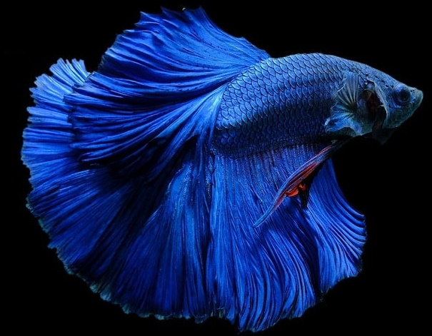
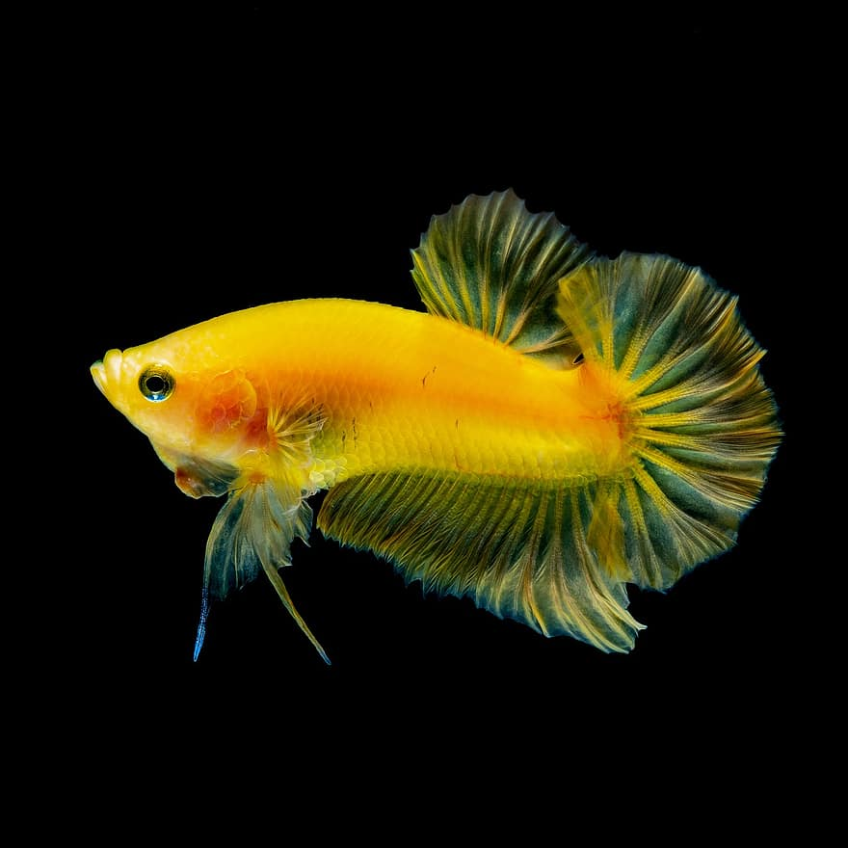
Solution
Dispensing Device
Dispenses 3 pellets at a time
Stores multiple weeks worth of food (> 100 pellets)
Sensors
Measures temperature (±1°F)
Measures acidity (±0.1pH)
App
Alerts when parameters are out of user-chosen-range of values
Displays tank conditions (temperature, pH, last feed, etc.)
User can configure custom feeding schedules
Notes:
Adan

Slide 4
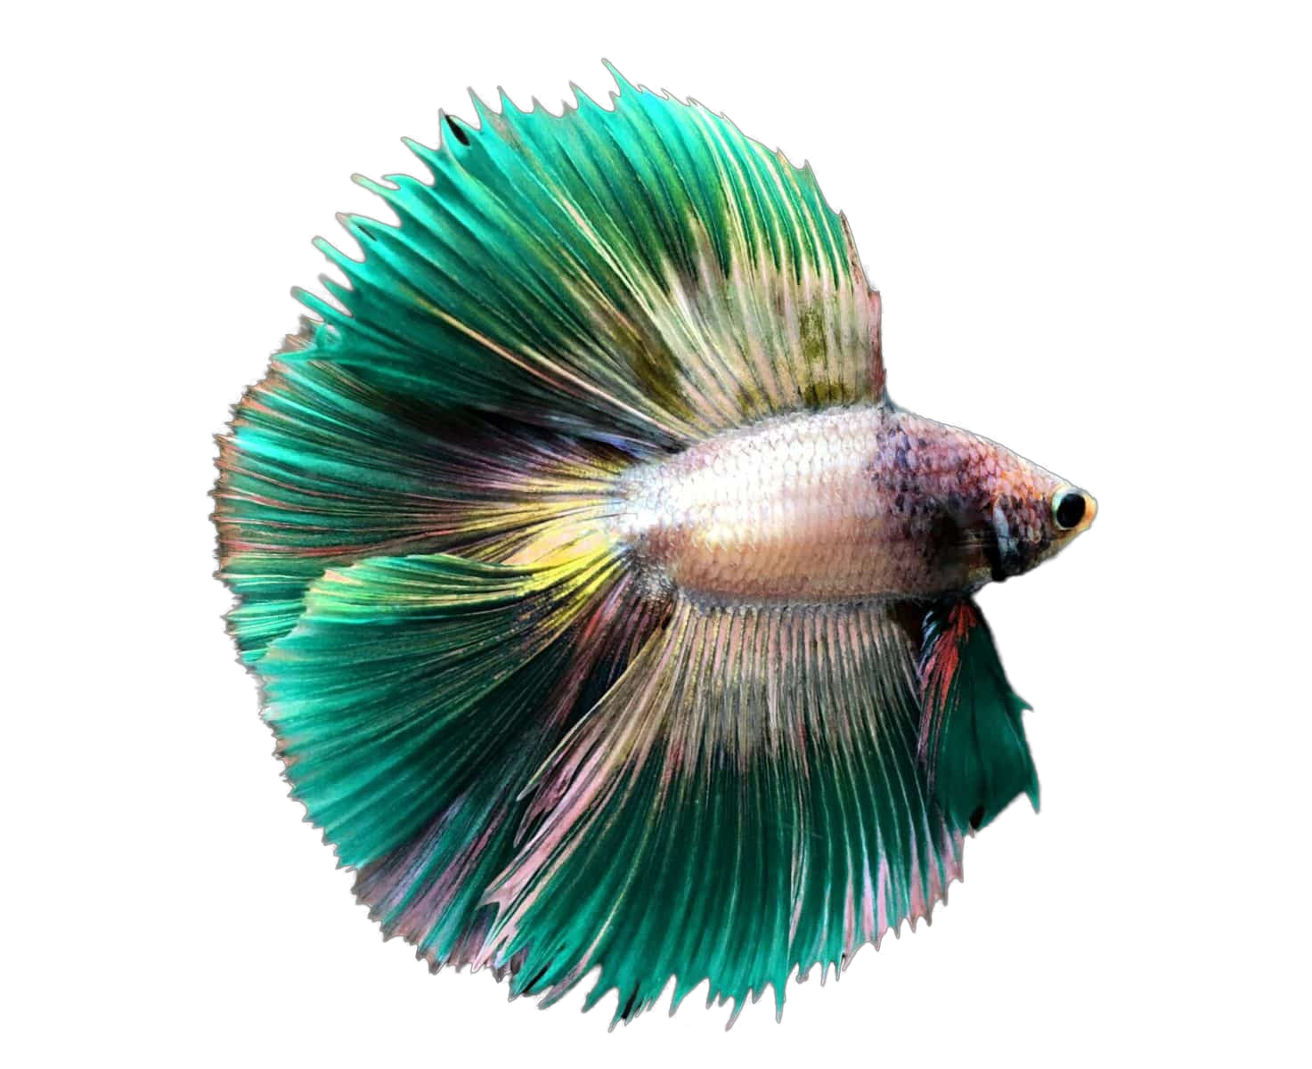
High-Level Diagram
Food Hopper
iPhone/ Computer
Flask Server
Dispensing Mechanism
Food presence sensor
MySQL Database
pH sensor
Temperature
sensor
Notes:
Adan - talk through with excitement - add details when presenting

Slide 5
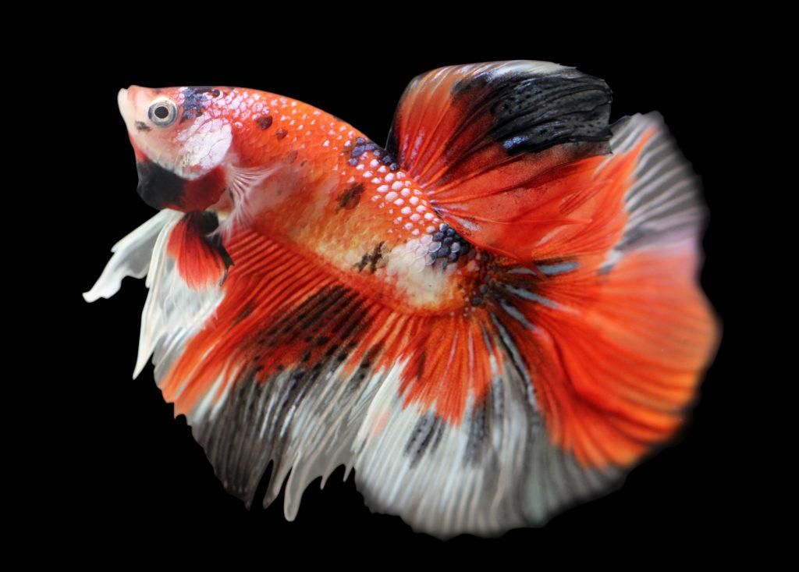
User Interface
Web for user ease
Pages for:
Dashboard
Edit Device
Schedules
Create Schedule
Edit Schedule
Settings
Notes:
Melanie

Slide 6
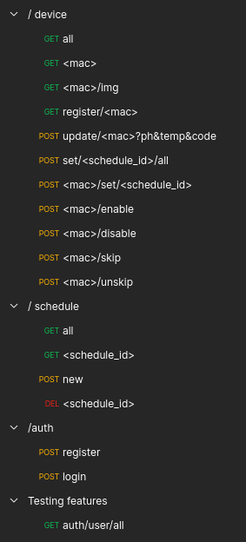
API
Created to ease the development of the front and back end individually
Separated based off of what each route modifies or retrieves
Easily adjustable for future growth
Created in postman to keep everything centralized
/auth for JSON Web Token retrieval
Notes:
Jack

Slide 7
Database Structures
Device
Device mac used to identify each connection
Name must be unique
Schedule is not required
Schedule
Days is a decimal representation of a binary string
Last and next are only ever set if a schedule is going to be used
The name must be unique
User
Public ID is used for jwt generation
Email and password for user authentication
Notes:
Jack

Slide 8
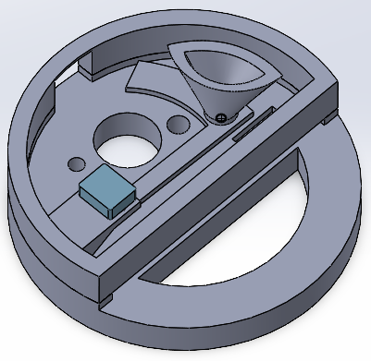
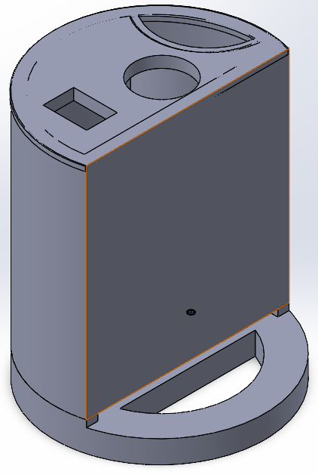
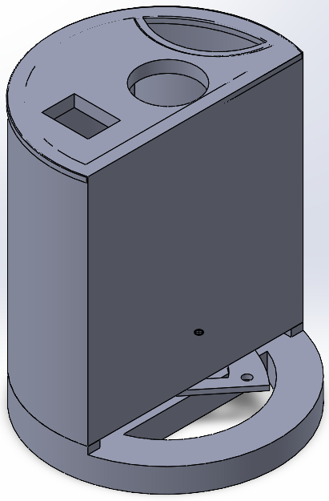
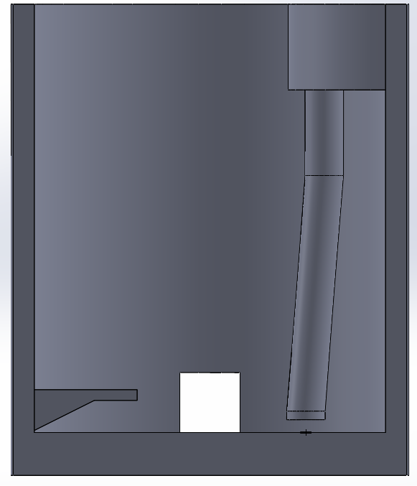
3D Models
Notes:
Brandon

Slide 9
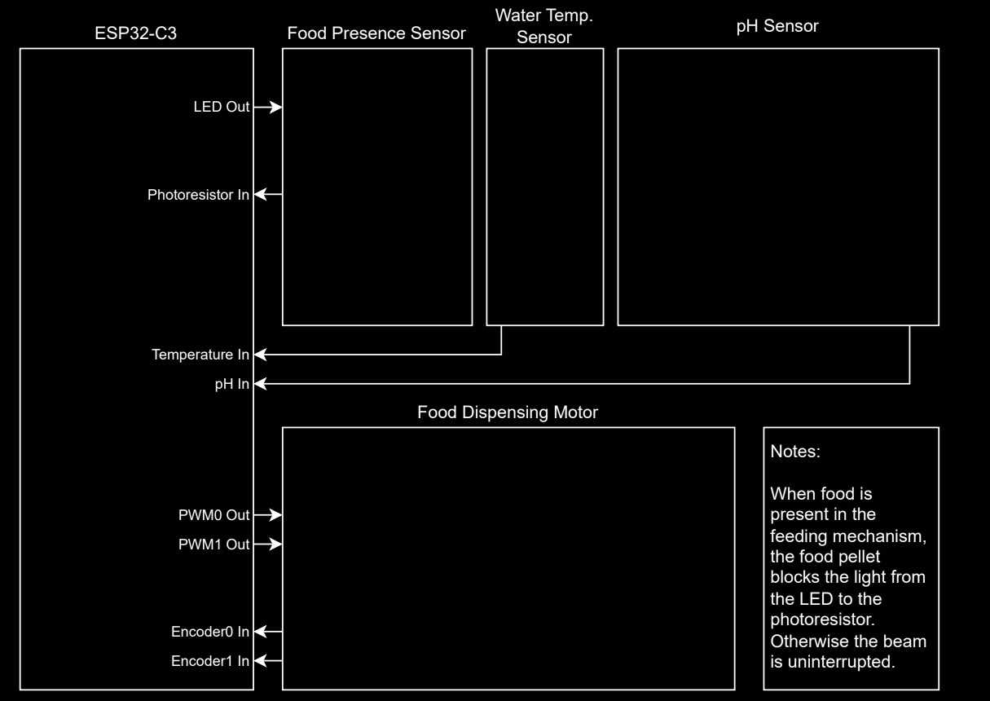
Circuit Design (High Level)
Notes:
Nathan

Slide 10
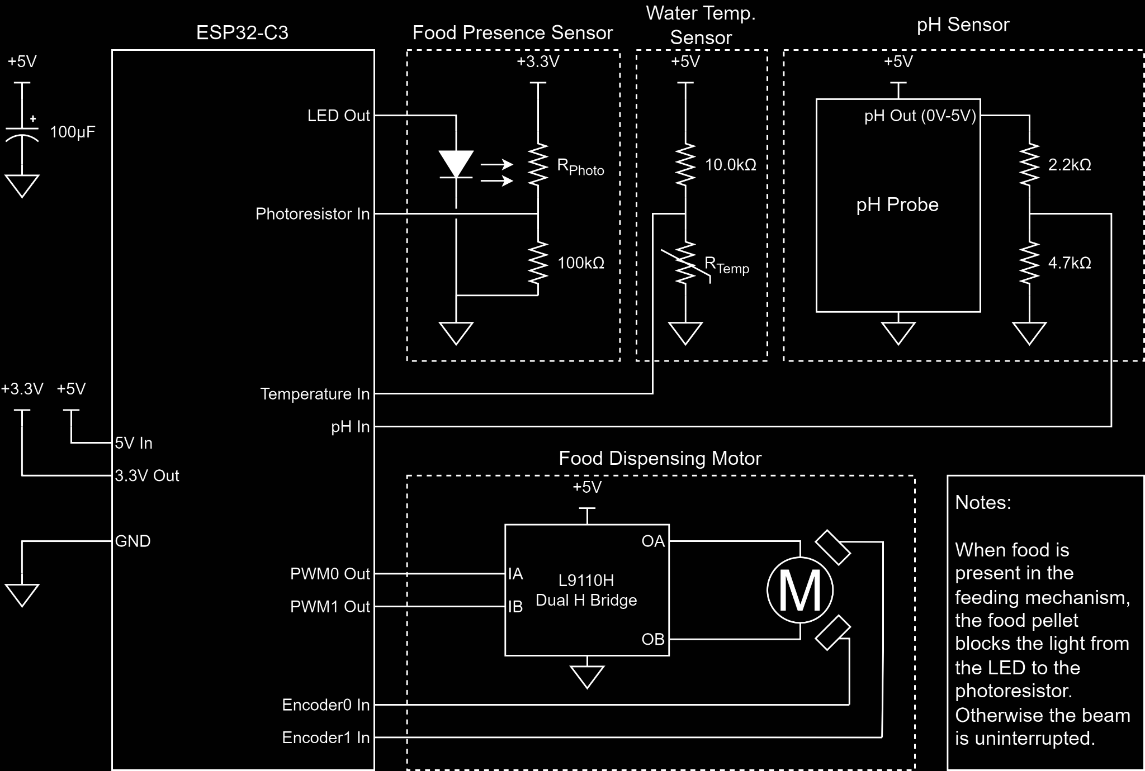
Circuit Design
Notes:
Nathan

Slide 11
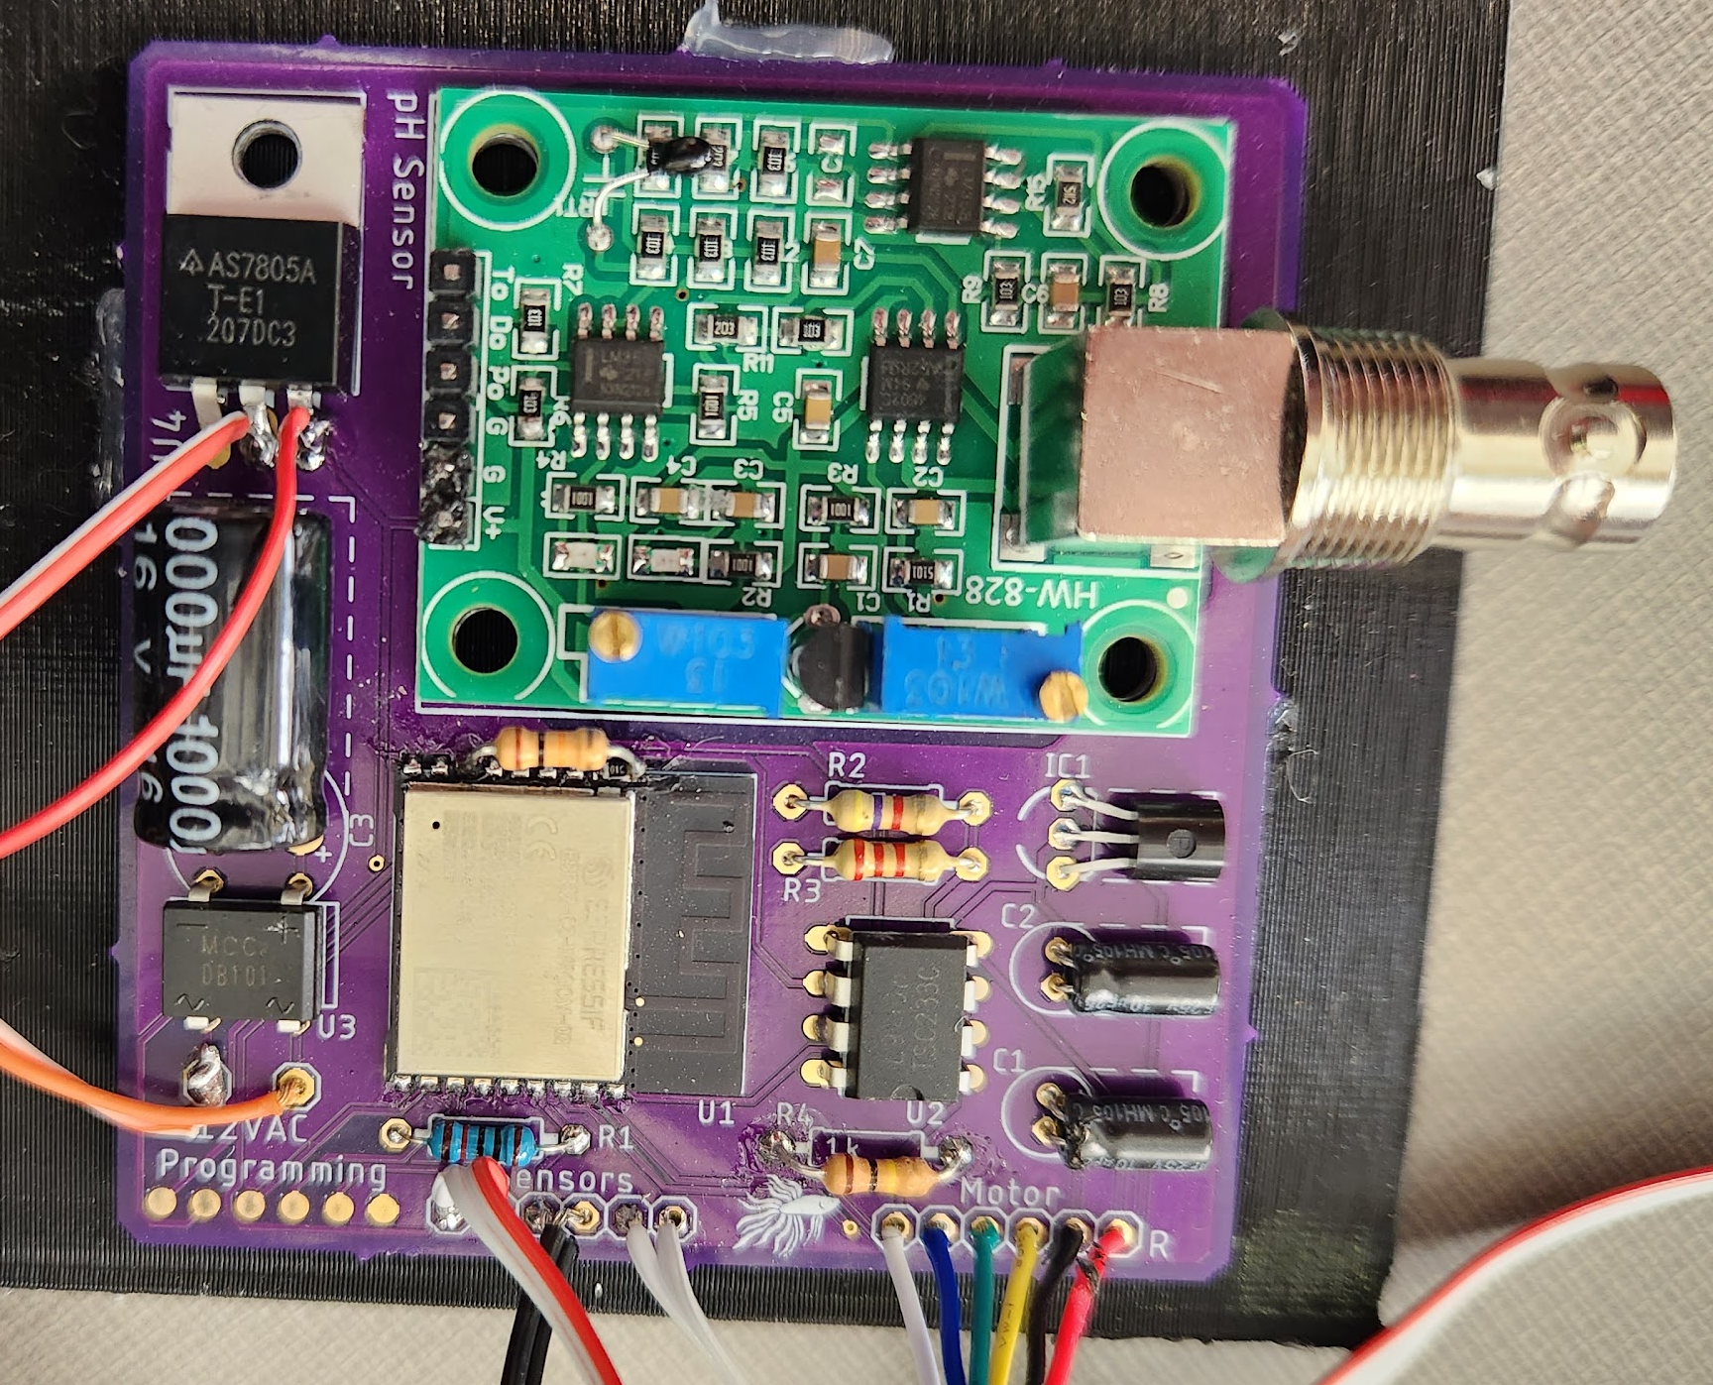
Circuit Board
Notes:
Nathan

Slide 12
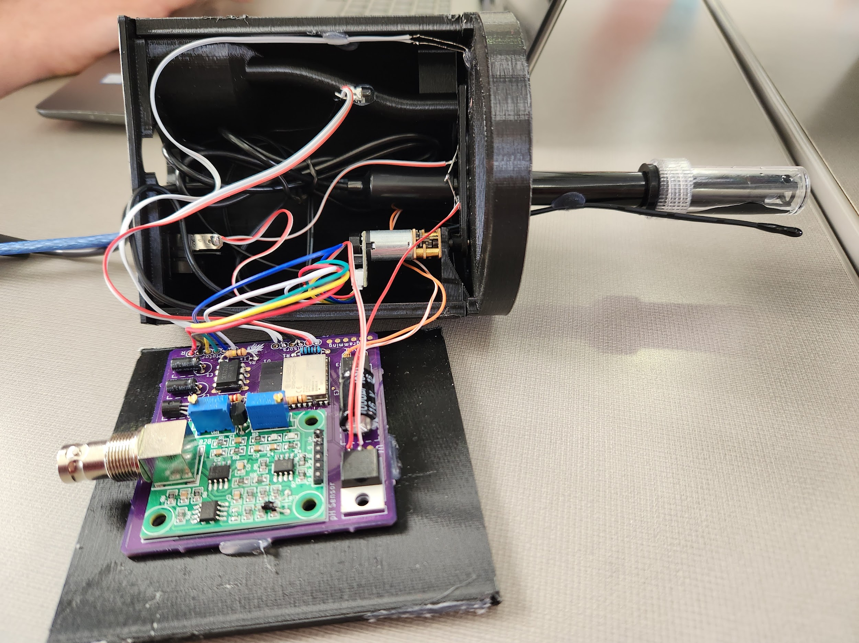
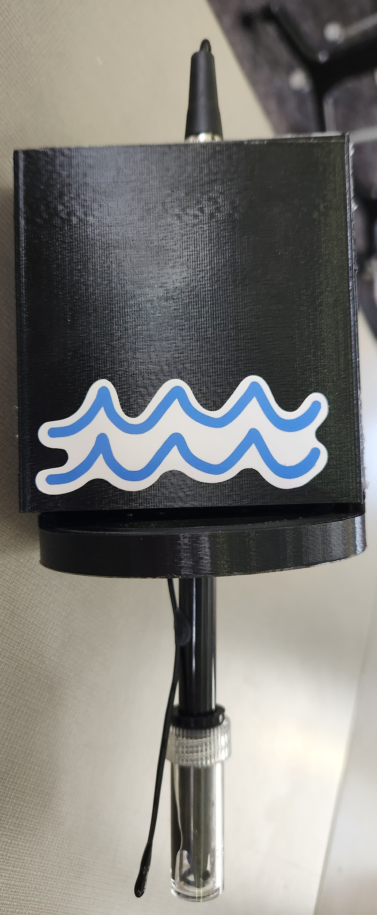
Feeding Mechanism
Notes:
Sarah

Slide 13
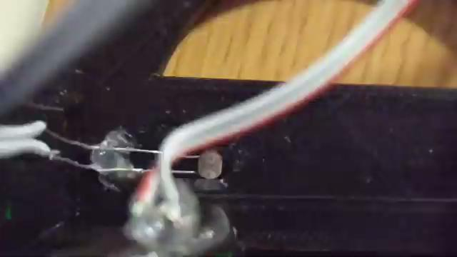
Notes:
Sarah

Slide 14
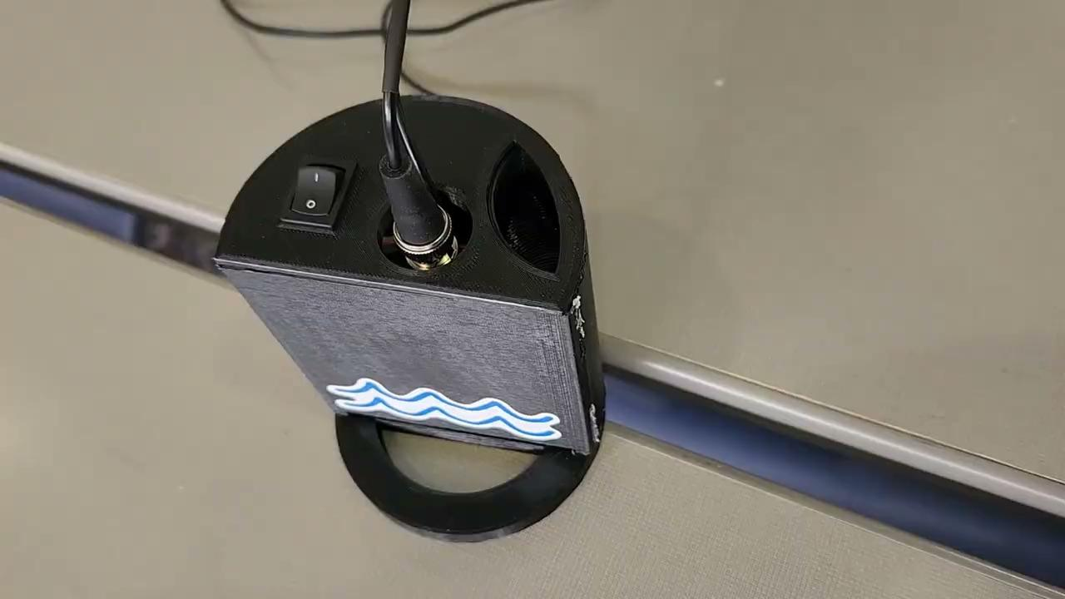
Notes:
Sarah

Slide 15
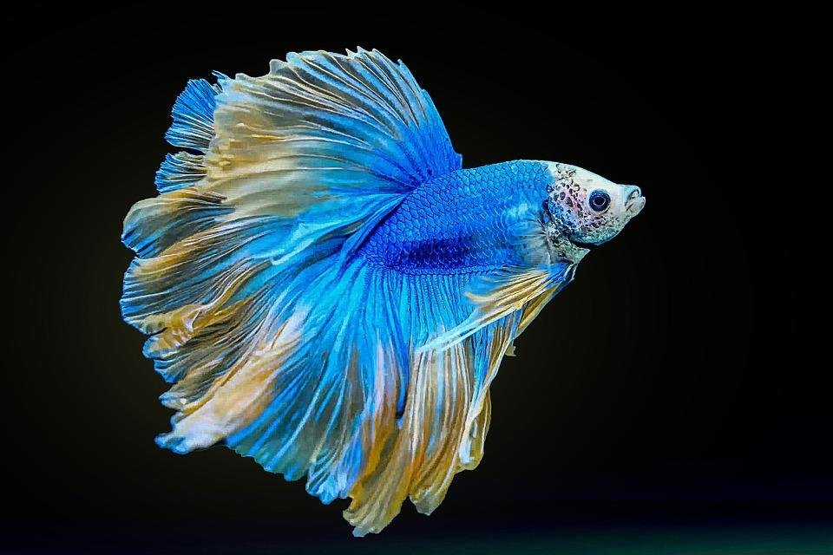
Key Contributions
Computer Engineering
Melanie Fuhrmann - UI
Nathan Paskach - Circuit Design and Firmware
Cyber Security Engineering
Isabella Leicht – Backend Analysis, Server Setup/Securing
Adan Maher – Frontend Analysis, Team Documentation
Electrical Engineering
Sarah Degen - Helping on feeder design ideas, Documentation
Brandon Mauss - 3D Modeling
Software Engineering
Jack Croghan - Backend Implementation
Notes:
Everyone

Slide 16
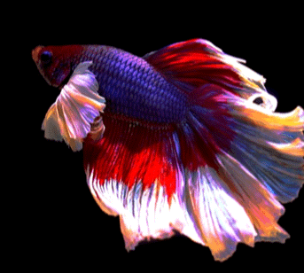
Challenges Solutions
Scrap iOS
Put the backend on a centralized location to allow the instance to not rely on an individual device
Add rectifier
Change the size for the hopper hole
Work through the errors
Apple Issues
XCode unresolvable errors
Connecting frontend and backend
AC Power supply
Food getting stuck in hopper
Server Errors
Notes:
Melanie and Nathan and Jack

Slide 17
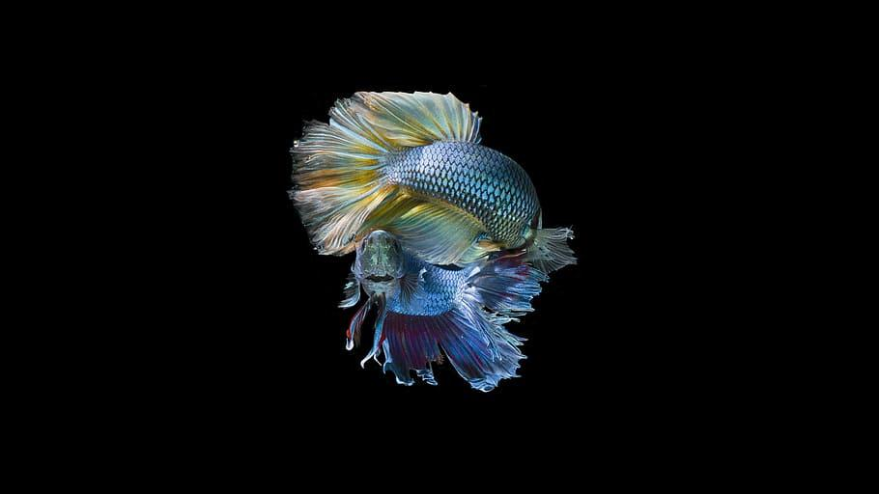
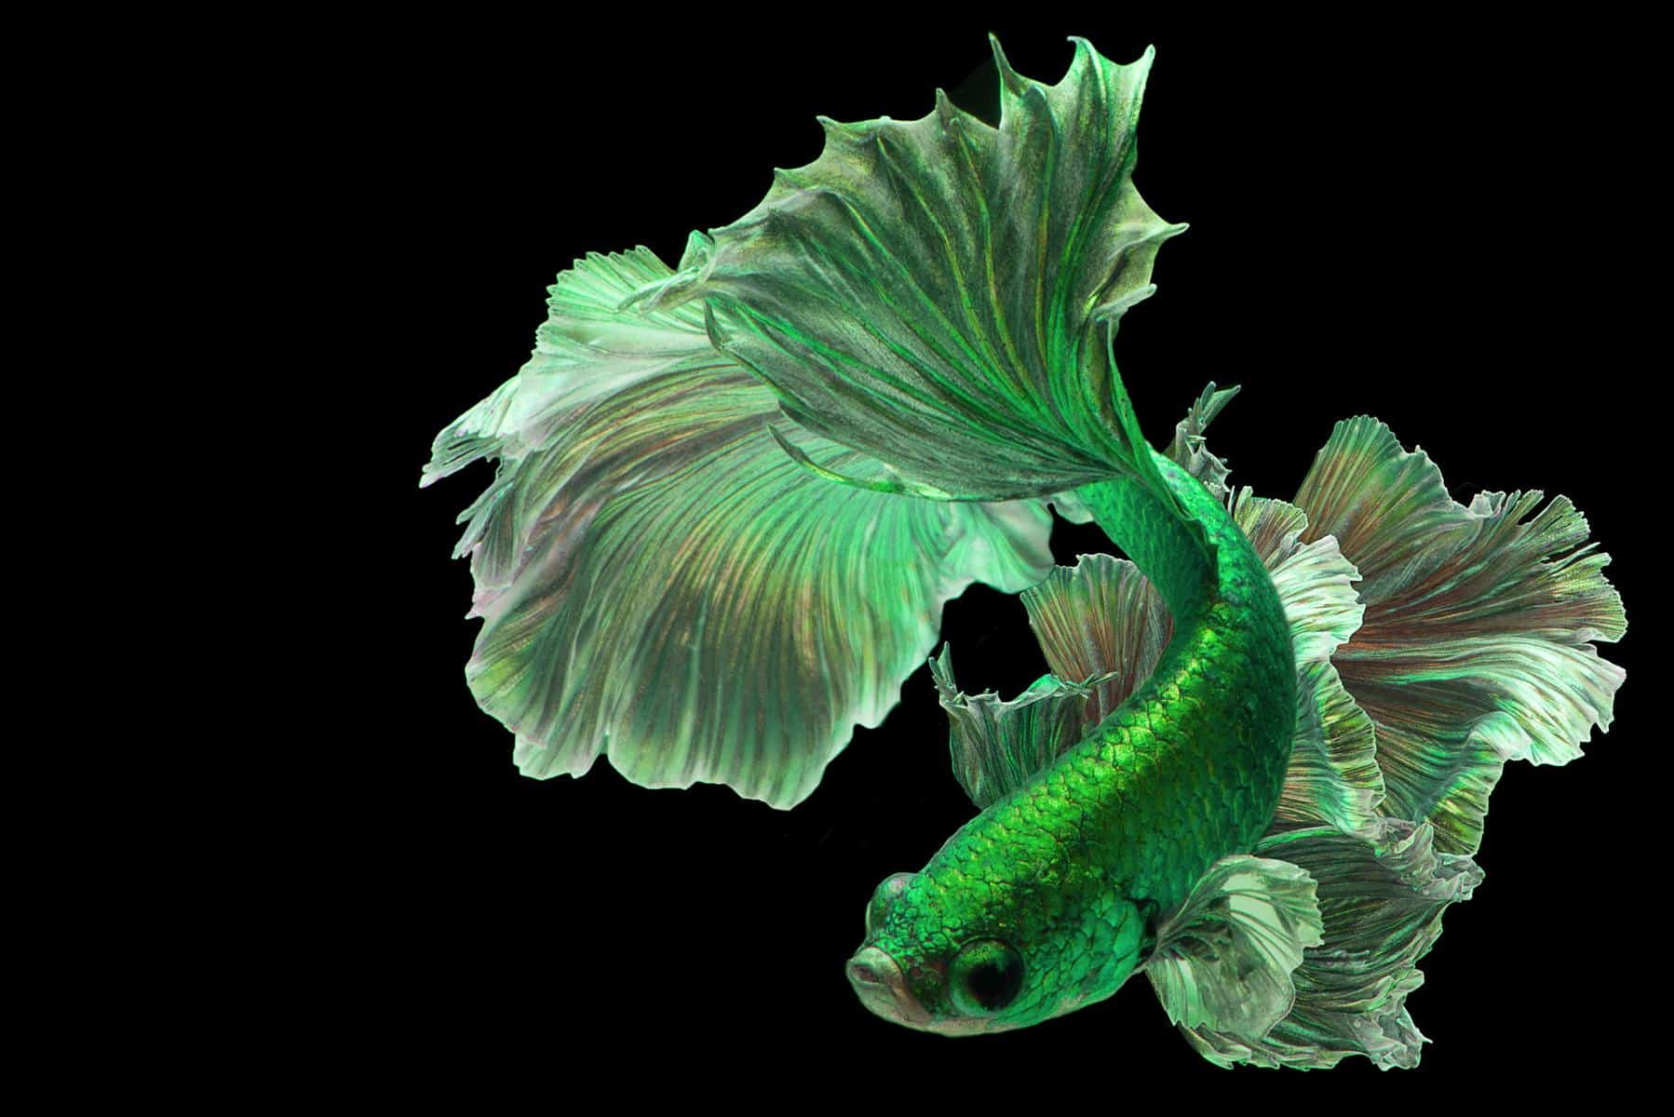
Next possible steps
Mechanism
Make devices for other fish tank designs
Have larger devices for several types of food
Have more sensors to detect quality of fish life
Be able to live stream to check in on fish
Software
Make the website have more functionality
Create an iOS app
Have a stronger server to handle more devices
Make the software more stable between front and back end
Notes:
Brandon for mechanism and Melanie/Jack for software

Slide 18
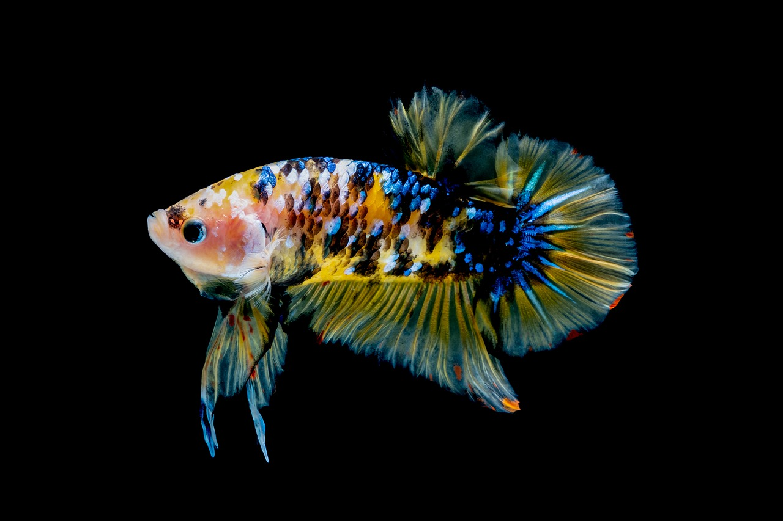
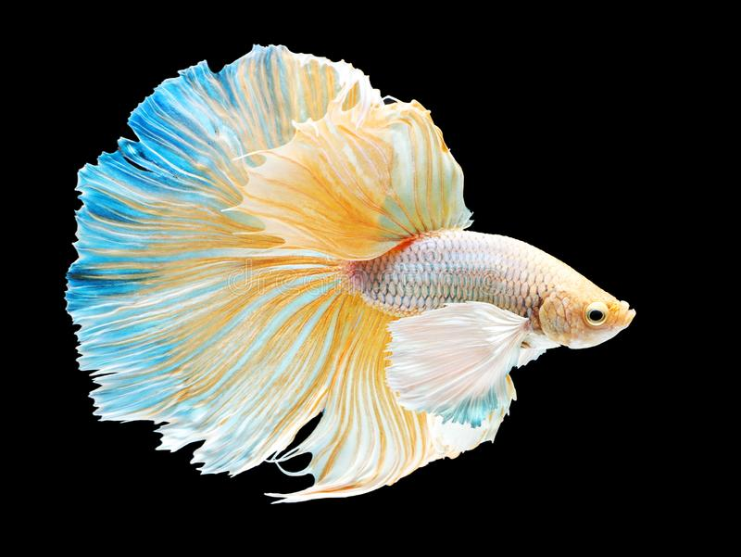
Conclusion
Mechanism
Firmware written
Sensors have been calibrated
Case parts printed
Connected to the backend
Software
Backend served and accessible from the broader internet
Backend API and authentication implemented
Dashboard, Schedule, Settings, Create/Edit Schedule pages created
Notes:
Brandon and Jack/Melanie

Slide 19
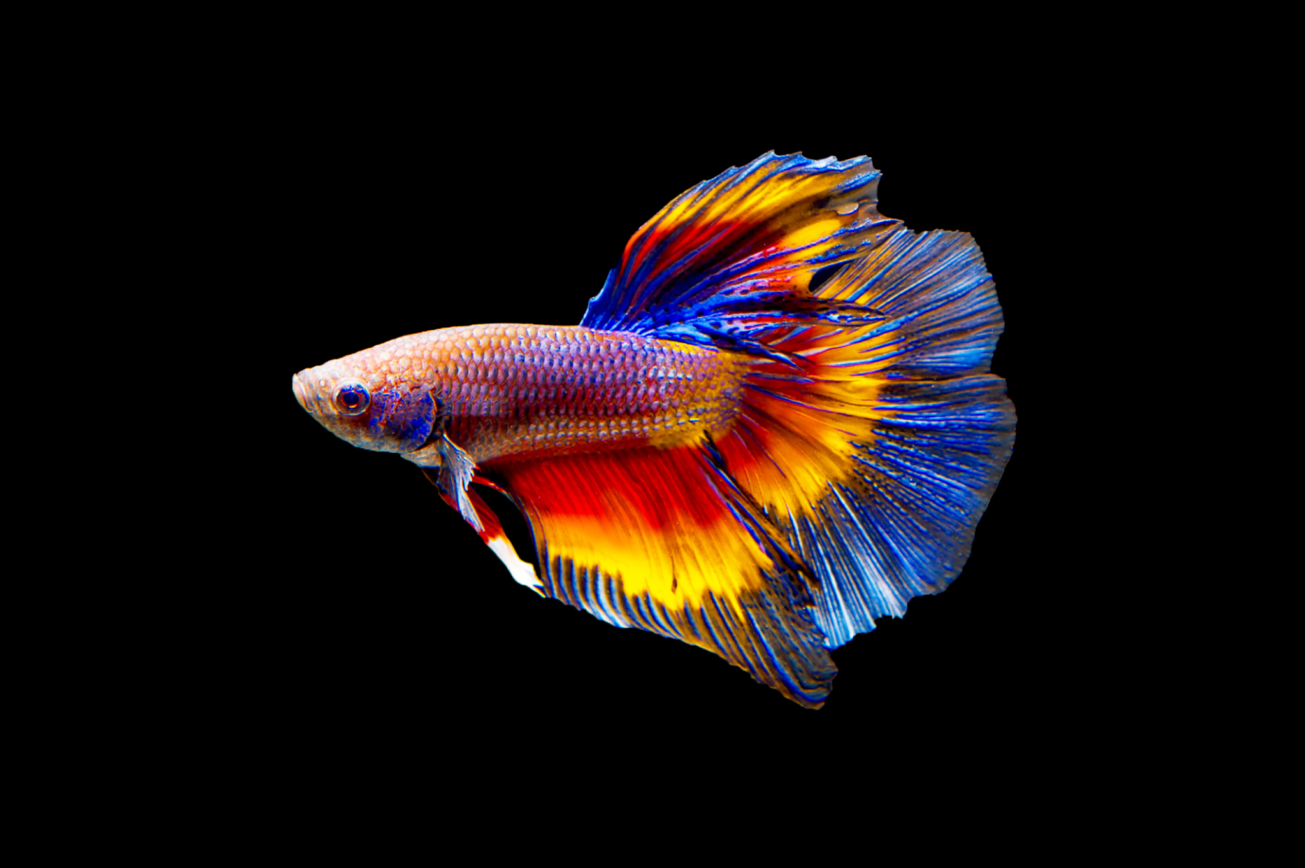
Financial Comparison
Ours X = # of feeder nodes
X = 1 : Unit price = ~$58.91
X >= 100 : Unit price = ~$45.34
X >= 1000 : Unit price = ~$44.79
Market Alternatives:
Fish Mate F14 Aquarium Fish Feeder: $27.99
Aquarium Auto Timer Food Dispenser for Vacation: $29.99
Eheim Automatic Twin Fish Feeder: $62.99
None are accessible remotely
None monitor water conditions
Finding solutions that cover all bases can rack up into $$$
Notes:
Esp32-c3-wroom-02 Bt Wifi Module 4/8/16mb Flash Esp32-c3-wroom-02-n4 Esp32-c3-wroom-02-n8 Esp32-c3-wroom-02-n16 - Buy Esp32-c3-wroom-02,Esp32-c3-wroom-02-n8,Esp32-c3-wroom-02-n16 Product on Alibaba.com
DB101-BP Micro Commercial Co | Discrete Semiconductor Products | DigiKey
AS7805AT-E1 Diodes Incorporated | Integrated Circuits (ICs) | DigiKey
4489 Adafruit Industries LLC | Integrated Circuits (ICs) | DigiKey
Mcp1700-3302e/to To-93 -3 Silk Screen 1700 3302e Microcontroller Ic Mcu New Original Chip - Buy Mcp1700-3302e/to,Mcp1700-4002e/to,Mcp1700-5002e/to Product on Alibaba.com
CF14JT2K20 Stackpole Electronics Inc | Resistors | DigiKey
CF14JT4K70 Stackpole Electronics Inc | Resistors | DigiKey
CF14JT10K0 Stackpole Electronics Inc | Resistors | DigiKey
QBL8IW15C-CW QT Brightek (QTB) | Optoelectronics | DigiKey
GRS-4011-1600 CW Industries | Switches | DigiKey
EEA-GA1C100H Panasonic Electronic Components | Capacitors | DigiKey
25PX1000MEFCT810X16 Rubycon | Capacitors | DigiKey
Gravity: Analog pH Sensor / Meter Kit for Arduino - DFRobot
Epoxy Probe Ntc Thermistor 10k 3950 100k Temperature Measuring Resistor Thermal Mf52 Wire Sensor For Water Oil Bms Temp Battery - Buy 10k 5k 2.5k 100k 50k 4.7k 500k 1m Ohm Thermal Resistor 0.1% 0.5% 1% 2% 0.5% 3% 5% 10% Ntc 20/22/24/26/28/30/32 Awg,Beta-value 3950 4150 4250 4050 3380 3435k Thermal Resistor Ntcle Epoxy Ceramic Chip Passive Components,Waterproof Thermal Resistor Pvc Fep Pp Tpe Ptfe Ptf Wire 100m 200m Pearl Probe Sensor Ntc Product on Alibaba.com
NSL-5162 Advanced Photonix | Mouser
Chihai Motor Chf-gm12-n20va M4 Screw Shaft Dc 3v 6v 12v 7ppr Encoder Motor Reducer - Buy Chihai Motor Chf-gm12-n20va-m4-0.5 Dc N20 Mini Gear Motor For Share Bike,Screw Shaft Dc 3v 6v 12v 7ppr Encoder Motor,12mm Mini Dc Gearbox Motor With Gear Ratio 298 Reducer Carbon Brush Gear Motor Dc Gear Motor Product on Alibaba.com

Slide 20
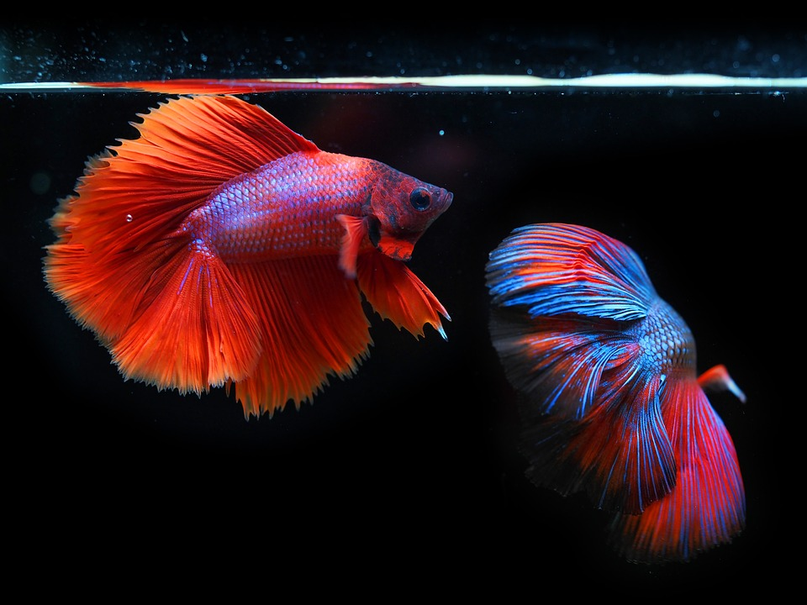
Fin

